Slide 1
Latin terms used in prescription writing
Debjani mukherjee
Asst.prof(bbahm )

Slide 2
INTRODUCTON
You may have seen abbreviations on prescriptions such as q.i.d. or b.i.d. and wondered what that meant. These and other instructions are written in abbreviations for Latin phrases. Centuries ago, all prescriptions were written in Latin. Now, only the directions for taking the drug have kept that trait.
WHAT IS LATIN ABBREVIATION ???

Slide 3
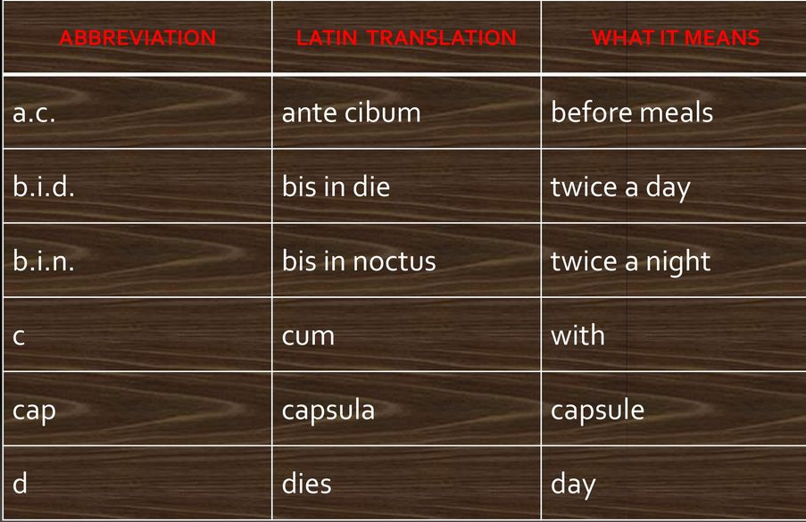

Slide 4
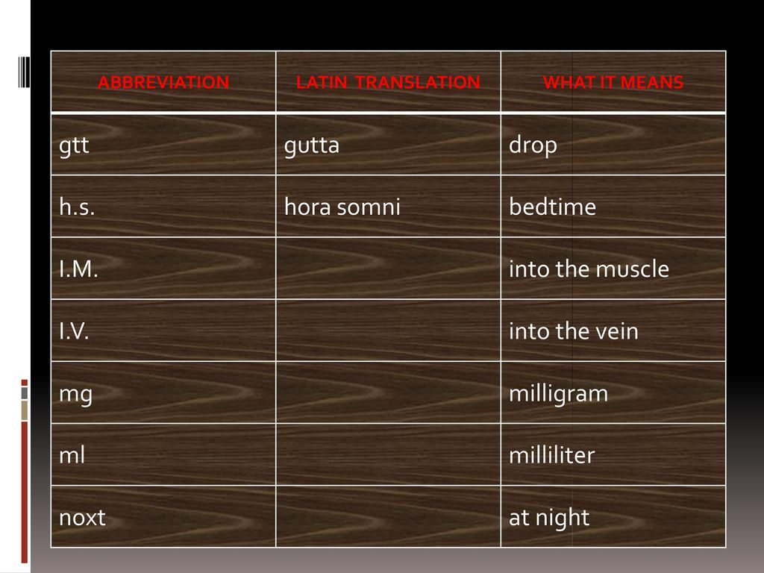

Slide 5
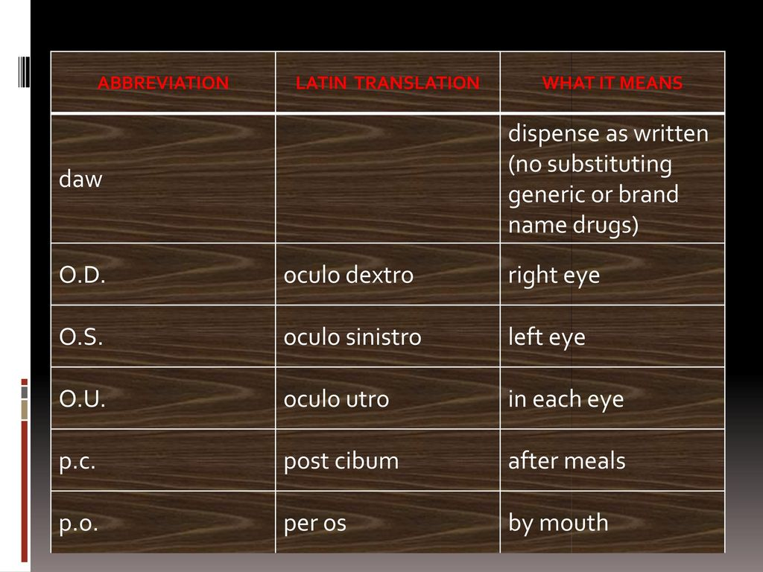

Slide 6
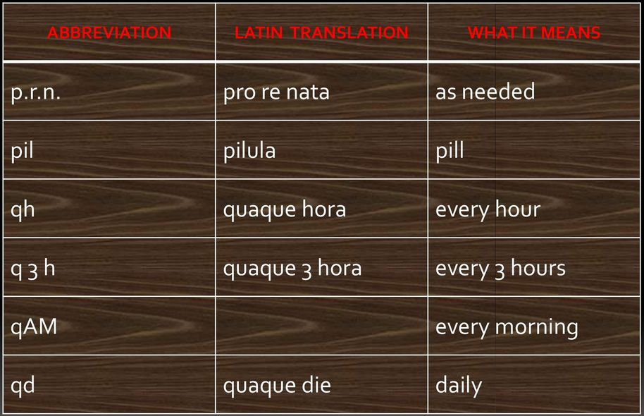

Slide 7
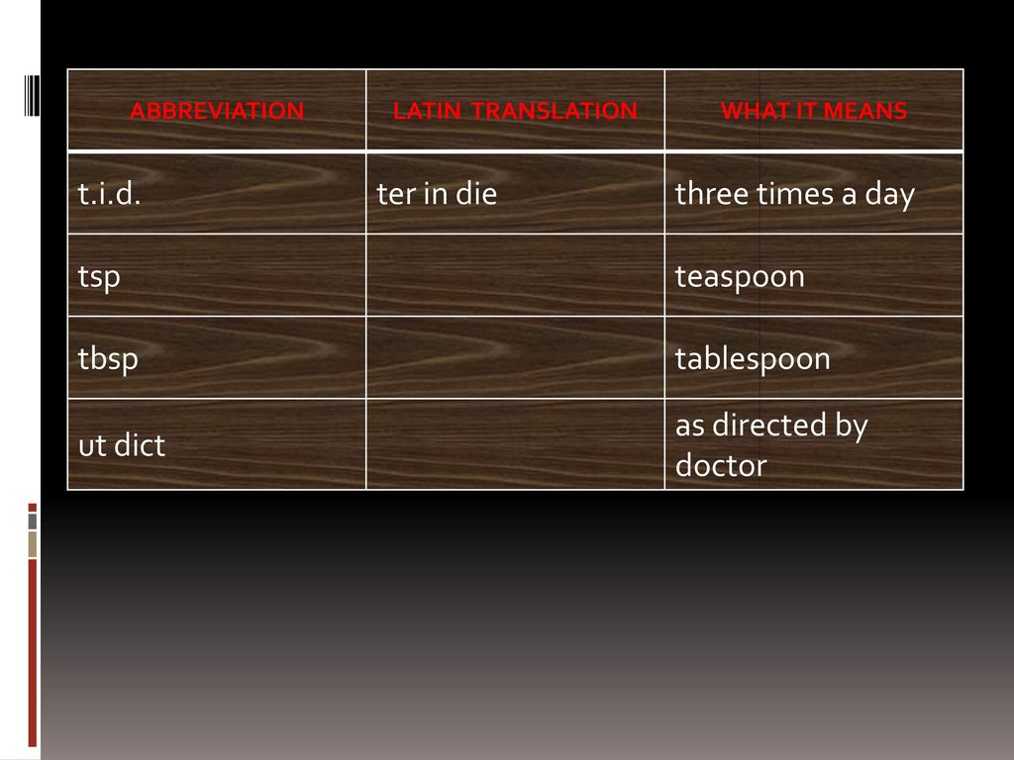

Slide 8
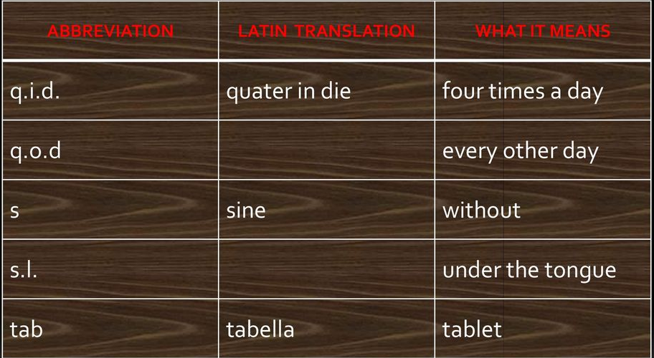

Slide 9

THANK YOU

